Slide 1
Hypersensitivity Reactions I & II
DR MANOJ RADHAKRISHNAN
DEPT OF PATHOLOGY AND MICROBIOLOGY
SKHMC

Slide 2
Definition of Hypersensitivity
In certain individuals repeated exposure to a specific antigen leads to adverse reactions ,(which is sometimes associated with tissue destruction)rather than induction of a protective immune response.

Slide 3
Pathogenic mechanisms underlying tissue destruction in hypersensitivity(Gell &coombs class)
Release of vasoactive and spasmogenic mediators of inflammation(type I)
Binding of antibodies to the antigens on cell surface,predisposing them to lysis of phagocytosis.(type II)
Formation of antigen-antibody complexes capable of activation of the complement system(type III)
Sensitization of T-lymphocytes after reaction with antigen leading to granulomatous inflammation initiated by CD4+ lymphocyte sensitization or leading to CD8+ killing of antigen bearing cells.(type IV)

Slide 4
Type | Immune recognition | Effector cell | onset | Disease
I | IgE | Mast cells & eosinophils | Immediate, late phase | Anaphylaxis, urticaria Angioedema, asthma
II | IgG,,M, A reaction on cell membrane bound Ag | Neutrophils, Monocytes Macrophages NK cells | Intermediate -hrs | A.I.hemolytic anemia Myasthenia gravis,graves’
III | IgM,IgG ,Ig A,circulating immune complex disease | Neutrophils | Intermediate -4-12 hrs | Serum sickness, SLE
IV | CD4+,CD 8+ Tcells 1.Delayed hypersensitivity 2.Cytotoxic T cells | Monocytes & macrophages CD8 Cells | Delayed > 24 hrs | Allograft rejection, GVHD, Contact sensitivity, Tub Leprosy

Slide 5
Type I Hypersensitivity(IgE mediated)
Also called Anaphylactic reactions
Develop rapidly within minutes following exposure to antigen in a previously sensitized individual.
Based on mast cell participation
Effects due to
Histamine(1ST Phase)
Leukotrienes , PGs & PAF (2nd phase)
Mediated by IgE in most instances.

Slide 6
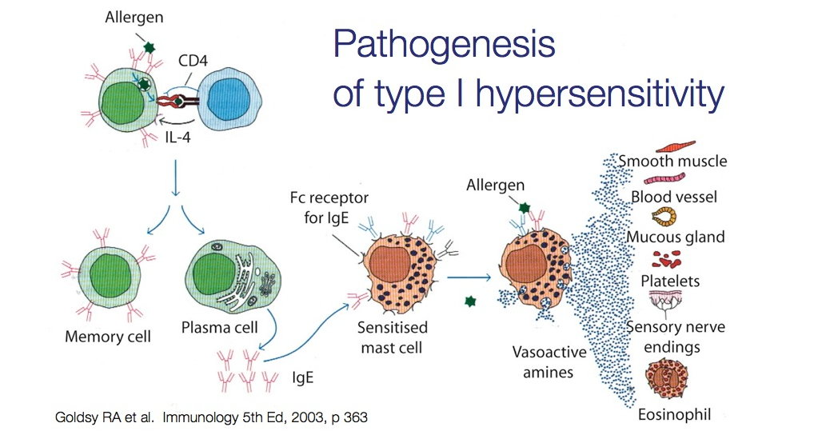

Slide 7
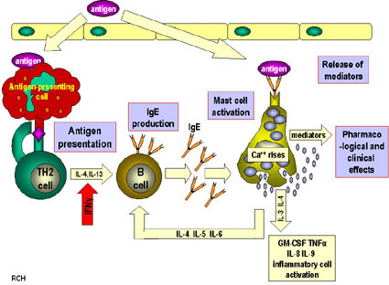

Slide 8
Type 1
2 phases
1ST phase(immediate)-15-20 min wheal & flare, acute bronchoconstriction,
does not need eosinophil
Mediated by histamine
2ND Late phase- lasts upto 24 hrs
recruitment of eosinophils & neutrophils
Mediated by leukotreines.PAF

Slide 9
Type I, location
Reactions may be localized or systemic
Localized:if the allergen is confined to the site of contact,localized edema and inflammation typically develop( eg Urticaria/hives-wheal &flare rhinitis,bowel-acute cramping pains & diarrhoea, or acute bronchoconstriction )
Systemic reaction:a life threatening anaphylactic reaction may develop ,especially if the antigen was introduced intravenously(eg antibiotic)

Slide 10
C/f of Anaphylaxis
After injection of drugs, hormones or antisera,into a previously sensitised person.
Anaphylactic shock is characterised by profound & immediate bronchospasm,hypotension,due to widespread vascular dilatation,generalised urticaria,widespread edema, difficulty breathing due to laryngospasm,laryngeal and pulmonary edema and cardiac dysrhythmia.

Slide 11
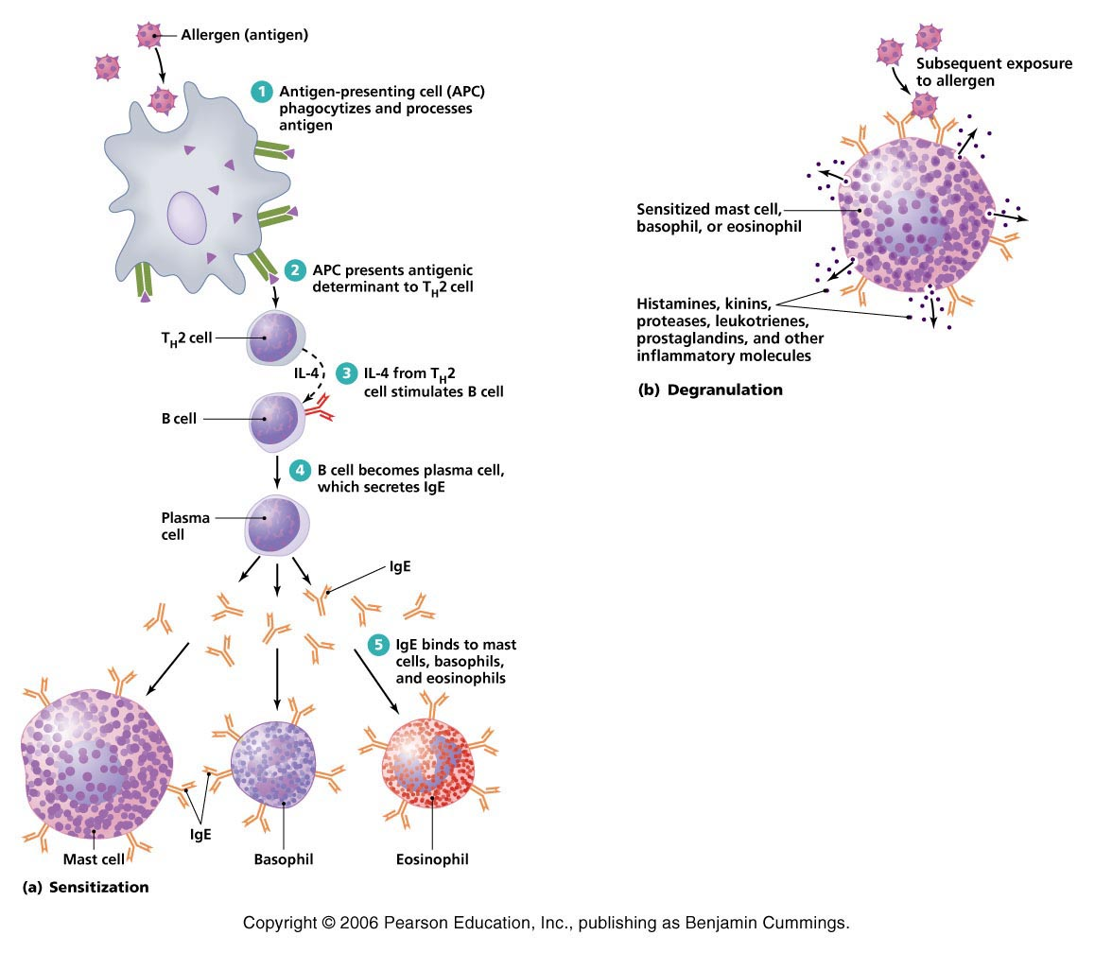

Slide 12
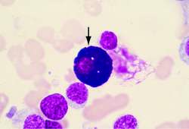
Mast cells

Slide 13
Examples of localised reaction:
Antigens entering through the skin,by inhalation,or through ingestion evokes a reaction usually limited to one organ system
Upp resp tract reactions: seasonal allergies caused by pollens(>10microns) evoke hay fever,similar but prolonged allergic rhinitis may result from exposure to dust mites.in both instances,there is nasal congestion,watery discharge,itching ,sneezing and cough.
GI Reactions: ingestion of allergens may lead to Diarrhea, Malabsorption syndrome, and protien losing enteropathy
Bronchopulmonary reactions:Asthma,example of hypersensitivity of small airways to inhaled allergens. It presents with wheezing,hypersecretion of mucus and coughing.
Skin reactions: Atopic dermatitis , a common disease of childhood

Slide 14
Cells involved-Th2 lymphocytes, B-lymphocytes mast cells
Immediate reaction-histamine,enzymes-chymase ,tryptase & heparin
Delayed reaction-leukotreines & prostaglandins,PAF

Slide 15
Type II Hypersensitivity(Antibody mediated reactions)
Antigen is present on the surface of the target cell.It maybe
Intrinsic antigen-eg Rh D Antigen
Antigen adsorbed on cell surface from environment-eg drugs acting as haptens

Slide 16
Type II mechanisms,examples
Complement mediated cell lysis:eg acute hemolytic reaction.
Antibody mediated cell mediated cytotoxicity:autoimmune hemolytic anemia and thrombocytopenia.
Antibody mediated cell dysfunction: eg Grave’s disease,myasthenia gravis

Slide 17
antibodies
Against red cells and platelets
Transf reaction(complement mediated lysis)
AIHA(opsonization)
ITP (opsonization)
Antibodies against tissue basement membranes
Goodpasteur’s syndrome
Pemphigus vulgaris
Receptor stimulating or blocking auto-antibodies
Myasthenia gravis
IDDM
Grave’s disease

Slide 18
type II –Important diseases
Transfusion reaction:
Hemolytic disease of the newborn: mediated by maternal IgG Antibodies to fetal Rh+Red cells.
Autoimmune hemolytic anemia: anti RBC antibodies
Pemphigus vulgaris:antibodies to protiens forming intercellular junctions(desmosomes) of the epidermis.
Goodpasture syndrome: pulmonary-renal disease caused by Ab that react with glomerular and pulmonary vascular basement membrane.

